Slide 1




Slide 2







Slide 3









Slide 4
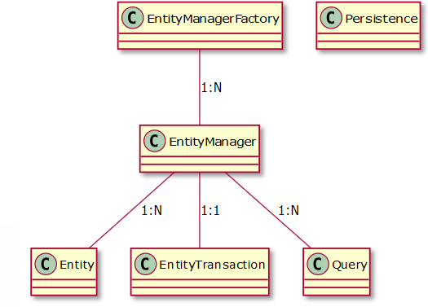

Slide 5







Slide 6






persist()
remove()
merge()
find()
lock()
detach()
refresh()

Slide 7





persist

Slide 8


merge

Slide 9



remove

Slide 10

refresh

Slide 11



commit
flush
commit
flush

Slide 12











Slide 13










Slide 14







Slide 15


Slide 16



Finding Entities Using the EntityManager
To find an entity by their ID, we use the EntityManager.find() method and pass the entity class and the entity ID as the parameters.
Relationship Direction has no impact on your database mapping, but it defines in which direction you can use the relationship in your domain model and JPQL or Criteria queries.
For BiDirectional Relationships, a query can navigate from say, Order and LineItem, a query could navigate in both directions because these two entities have a bidirectional relationship.

Slide 17





-
-
-

Slide 18








